Slide 1

API GATEWAY

Slide 2

Agenda
the problem
SOLUTION
Hands-on

Slide 3

1
the problem

Slide 4
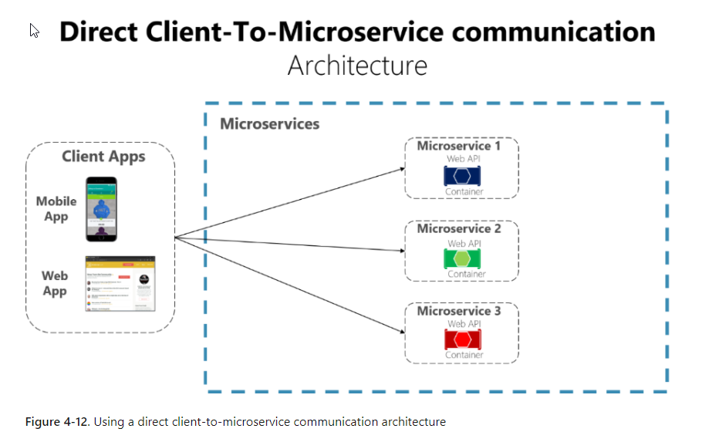
the problem
microsoft.com

Slide 5



Each microservice has a public API
Good enough for small microservices based architecture
What will happen when we’ll have dozens of microservices of different types?
What will happen when we’ll have multiple clients? (SPAs, mobile clients)
Notes:
Elements (version 3)
Elements are used to give more detail to a set of ideas, they should all relate to the same topic.
Use this page for a list of deliverables, key roles on a project, phases of a project, or any topic that can be broken down into more specific examples.
Each section should have an icon that relates to the content of that specific element, no icon should be repeated on the same page, and they should all be the same colour.
Keep the text to 1-2 sentences and aim to have about the same amount of content under each element.
If icons do not look good, take up too much room, or are not visually working, refer to “Standard text slide v8 and v9”.

Slide 6



How can client applications optimize the number of requests to the backend?
How can we handle cross cutting concerns such as authorization, authentication, data mapping?
How can client apps communicate with services that use non-internet friendly protocols?
How can you shape different APIs specially made for mobile applications?
Notes:
Data slide (version 5)
Tables are mostly used to show the cost of the project.
If the table is not too extensive, as shown here, use elements to reinforce or remind the audience of key ideas or information.

Slide 7

Coupling
Too many round trips
Security issues
With direct communication the client APIs are tightly coupled to the microservices. The client application needs to know multiple areas of the microservice landscape. In case of refactoring which may cause breaking changes, the client apps will need to be updated frequently making it harder for the solution to evolve
A single screen in the application might require several calls to multiple services. This approach can lead to multiple network round trips causing a significant latency
All microservices are public, exposed to the outer world making the attack surface larger than if some of the microservices are hidden and not used directly by the client apps.
Cross cutting concerns
Each publicly published microservice must handle concerns such as authorization and SSL. In many situations, those concerns could be handled in a single tier so the internal microservices are simplified.
Notes:
Elements (version 4)
Elements are used to give more detail to a set of ideas, they should all relate to the same topic.
Use this page for a list of deliverables, key roles on a project, phases of a project, or any topic that can be broken down into more specific examples.
Each section should have an icon that relates to the content of that specific element, no icon should be repeated on the same page, and they should all be the same colour.
Use this version when there are less examples to breakdown with more text associated with the element.

Slide 8
1
Solution

Slide 9
API Gateway pattern
Single point of entry for certain groups of microservices
solution
Sits between the client apps and the microservices
Request routing from clients to services

Slide 10
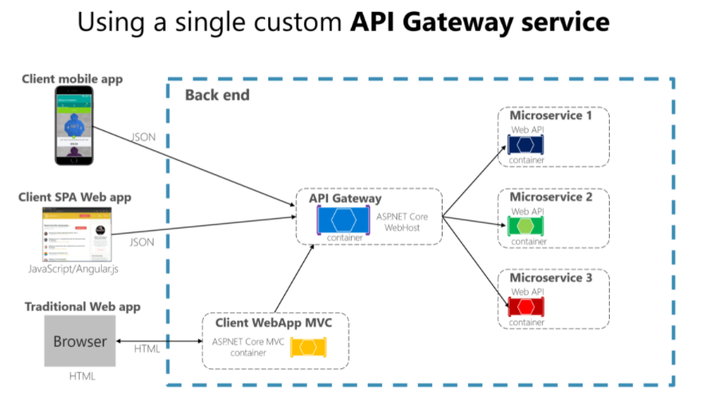
API gateway
microsoft.com

Slide 11


Single API Gateway serving multiple and different client applications
The API service will grow and evolve and eventually will be evolved and it will act as a monolithic service / aggregator => it is violating the microservice autonomy by coupling all microservices
API gateways should be segregated based on business boundaries and client applications and NOT act as a single aggregator
Notes:
Elements (version 4)
Elements are used to give more detail to a set of ideas, they should all relate to the same topic.
Use this page for a list of deliverables, key roles on a project, phases of a project, or any topic that can be broken down into more specific examples.
Each section should have an icon that relates to the content of that specific element, no icon should be repeated on the same page, and they should all be the same colour.
Use this version when there are less examples to breakdown with more text associated with the element.

Slide 12
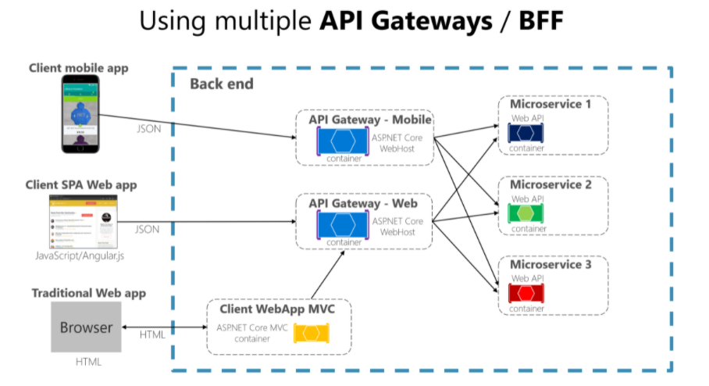
API gateway
microsoft.com

Slide 13
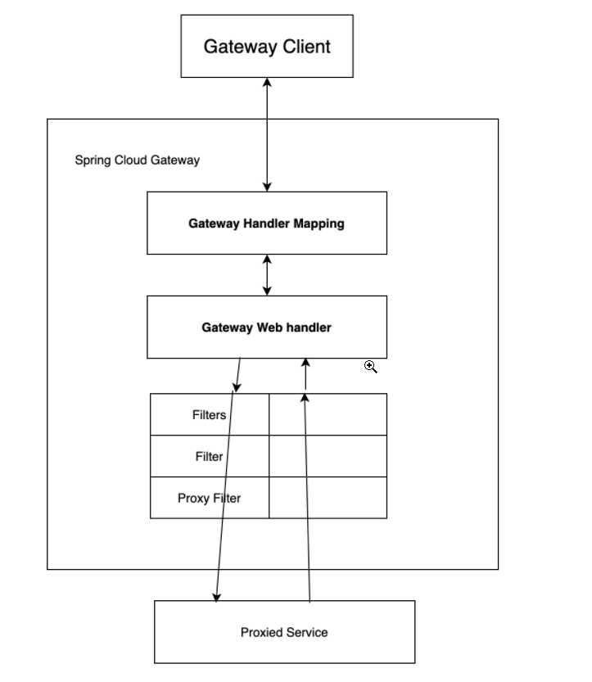
Spring cloud
gateway

Slide 14
Main features of API gateway
An API gateway can offer multiple features depending on the product. The most basic features that every API gateway should support are the following
Gateway routing or reverse proxy
Redirect requests to the endpoints of the internal microservice. By doing this it decouples the client applications from the microservices. It can also help with the modernization of a monolithic API
Request aggregation
Aggregate multiple client requests targeting multiple internal services into a single client request. This pattern is especially convenient when the client app needs data from multiple services. With this approach, the client sends only one request, the Gateway is dispatching the request to the services and in the end, it is aggregating the results
Cross cutting concerns
Authentication and authorization Response caching Retry policies / circuit breaking Correlation of the request IP allow listing
Data transformation or enrichment
Enrich the request or the response based on certain requirements: add a correlation header to trace how the initial request flows through all microservices
Notes:
Data slide (version 5)
Tables are mostly used to show the cost of the project.
If the table is not too extensive, as shown here, use elements to reinforce or remind the audience of key ideas or information.

Slide 15
1
Hands-on

